Slide 1
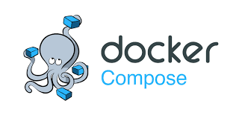
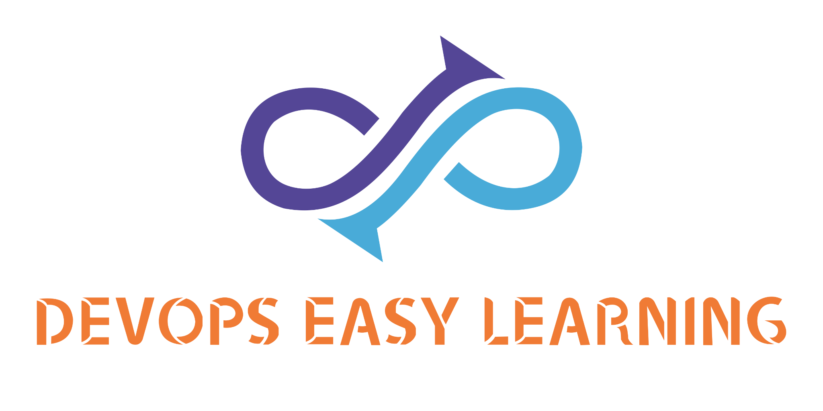

Docker-compose
limitations

Slide 2
Docker-compose
limitations

Slide 3

INTRO
There is no doubt that so far you are very happy and excited to know that docker-compose makes it very easy and efficient to deploy multiples containers at the same time, but it has lot of limitations.

Slide 4

Issue: upgrade service
When you run docker-compose up -d if there was a change on the image docker-compose will first stop the current service before it restart it so that it comes with new changes.
The problem here is that from the time a service stop and start can elapse few seconds which is very fatal for customers, as a devops engineer we wew are highly paid to make sure that the application will always be available 24/7 no matter what.
Can you image if the amazon or uber app have to stop for a minute only how many millions of dollar are they going to lose

Slide 5
Issue: Not on-demand Auto-scaling
In docker-compose although we can pass an option to ask a service to restart as needed there is a crucial problem because with docker compose it is impossible to automatically scale up and down services.
We all know that service in docker-compose are made of containers now a container is just a simplified VM therefore it has cpu and memory, now when the either the cpu and or memory get full or about to get full the containers will start misbehaving therefore affecting the application running inside.
unfortunately docker-compose is not smart enough to scale or create another service to reduce the load. Such issue can shutdown the application and make customers very angry.

Slide 6
Issue: single point of failure
As you guys have noticed all docker-compose services run inside a single virtual machine.
Now if the virtual machine itself crash or start misbehaving(maybe docker daemon stop working) it will automatically affect all containers (services) running inside.
Such failure in IT is called a single point of failure meaning one thing fails and all the application is affected.
As a devops engineer we get pay 6 figures to make sure that is does not happen.

Slide 7
Issue: Not fault-tolerant
The objective of creating a fault-tolerant system or application is to prevent disruptions arising from a single point of failure, ensuring the high availability and business continuity of mission-critical applications or systems.
Fault-tolerant systems use backup components that automatically take the place of failed components, ensuring no loss of service.

Slide 8
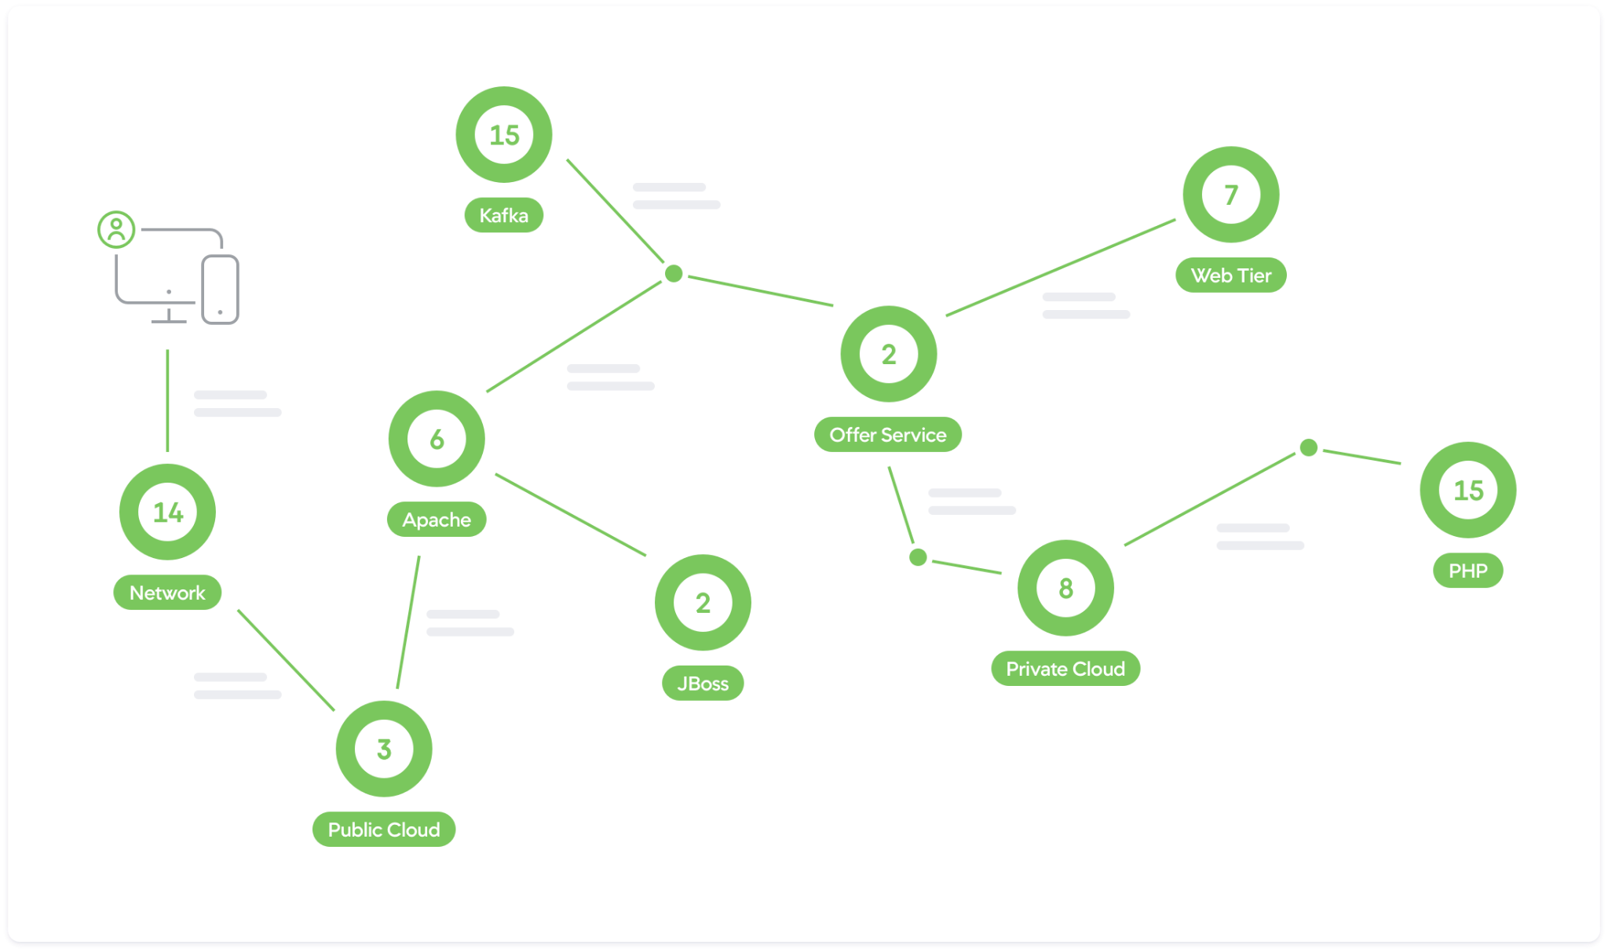
Issue: Auto discovery
The goal of DevOps engineers is to make sure that an application can discover other applications automatically, and communicate with each other.
Unfortunately Docker-compose make it very had to easily make applications automatically discover others applications.

Slide 9
Issue: NO update/rollback without any downtime
As DevOps engineer we are very lazy, and want to use tools that are smart enough to help us.
In production we always want a tools that are capable to automatically rollback the application should any issue arise while upgrading the application all this with zero downtime meaning the application should always be running an never stop while it is being rolling back
Unfortunately docker-compose does not offer such feature.

Slide 10

Issue: NO Self-healing mechanisms
Services sometimes fail for no reason, unfortunately devops engineers are not always around to fix the issue right away, therefore devops engineers like to use tools that are capable to restarts containers that fail, replaces containers, kills containers that don’t respond to health checks, etc.
Docker-compose does not offer such feature.

Slide 11

Question
Ok, ok, we heard you Eric, now if docker-compose have all these limitations, why are you teaching this to us, are you wasting our precious time, moreover, where is it used in the software lifecycle.
Good question, see you in class an answer will be presented to you.

